Slide 1
Chapter: 03(04)
Time Value of Money

Slide 2
What is Time Value of Money?
Time value of money is based on the belief that a dollar today is worth more than a dollar that will be received at some future date because the money it now can be invested & earn positive return.

Slide 3
Cash Flow Time Lines
Time 0 is today; Time 1 is one period from today
Interest rate
Time
0
1
2
3
4
5
5%
Cash Flows
-100
105
Outflow
Inflow

Slide 4
Future Value
Compounding
  The process of determining the value of a cash flow or series of cash flows some time in the future when compound interest is applied.
  The amount to which a cash flow or series of cash flows will grow over a given period of time when compounded at a given interest rate

Slide 5
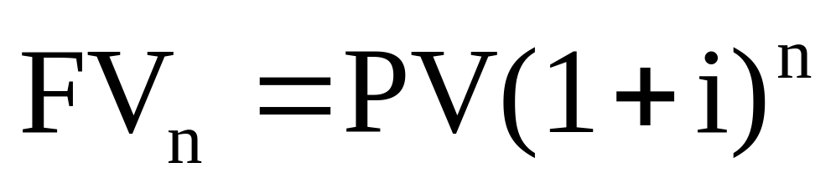
Compounded Interest
Interest earned on interest

Slide 6
Cash Flow Time Lines
Time
0
5%
1
2
3
4
5
-100
Interest
5.00
5.25
5.51
5.79
6.08
Total Value 105.00
110.25
115.76
121.55
127.63

Slide 7
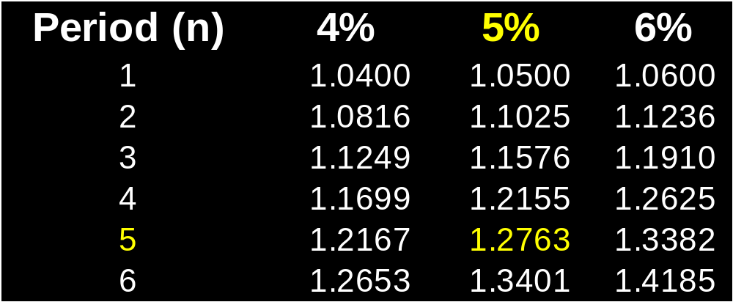
Future Value Interest Factor for i and n (FVIF_{i,n})
FV_{n} = PV(1 + i)^{n} = PV(FVIF^{i,n})
For $100 at i = 5% and n = 5 periods

Slide 8
Future Value Interest Factor for i and n (FVIF_{i,n})
FV_{n} = PV(1 + i)^{n} = PV(FVIF_{i,n})
For $100 at i = 5% and n = 5 periods
$100 (1.2763) = $127.63

Slide 9
Financial Calculator Solution
Five keys for variable input
  N = the number of periods
  I = interest rate per period
  may be I, INT, or I/Y
  PV = present value
  PMT = annuity payment
  FV = future value

Slide 10
Two Solutions
Find the future value of $100 at 5% interest per year for five years
1. Numerical Solution:
Time
0
1
2
3
4
5
5%
Cash Flows
-100
5.00
5.25
5.51
5.79
6.08
Total Value 105.00
110.25
115.76
121.55
127.63
FV₅ = $100(1.05)⁵ = $100(1.2763) = $127.63

Slide 11
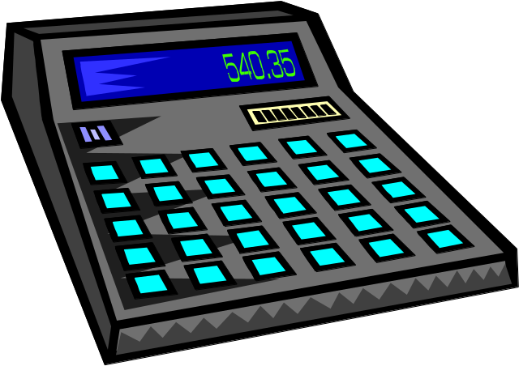
Two Solutions
2. Financial Calculator Solution:
Inputs: N = 5 I = 5 PV = -100 PMT = 0 FV = ?
Output: = 127.63

Slide 12
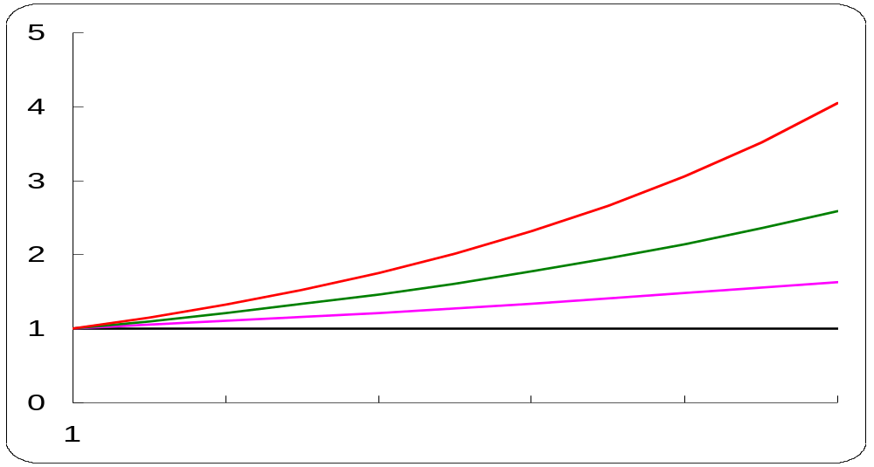
Graphic View of the Compounding Process: Growth
Relationship among Future Value, Growth or Interest Rates, and Time
Future Value of $1
i= 15%
i= 10%
i= 5%
i= 0%
2
4
6
8
10
0
Periods

Slide 13
Present Value
The present value is the value today of a future cash flow or series of cash flows
The process of finding the present value is discounting, and is the reverse of compounding
Opportunity cost becomes a factor in discounting

Slide 14
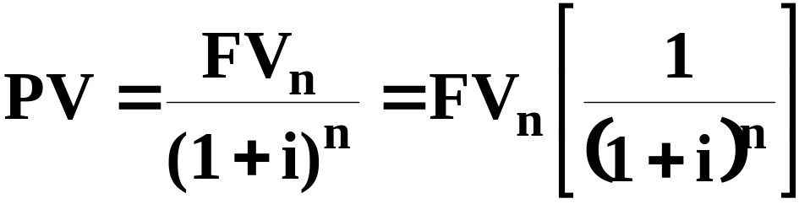
Present Value
Start with future value:
FV_{n} = PV(1 + i)^{n}

Slide 15
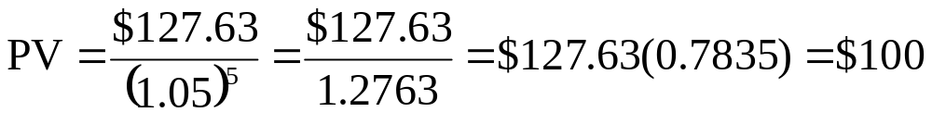
Two Solutions
Find the present value of $127.63 in five years when the opportunity cost rate is 5%
1. Numerical Solution:
0
1
2
3
4
5
5%
PV = ?
÷ 1.05
÷ 1.05
÷ 1.05
÷ 1.05
127.63
-100.00
105.00
110.25
115.76
121.55

Slide 16
Two Solutions
Find the present value of $127.63 in five years when the opportunity cost rate is 5%
2. Financial Calculator Solution:
Inputs: N = 5 I = 5 PMT = 0 FV = 127.63 PV = ?
Output: = -100

Slide 17
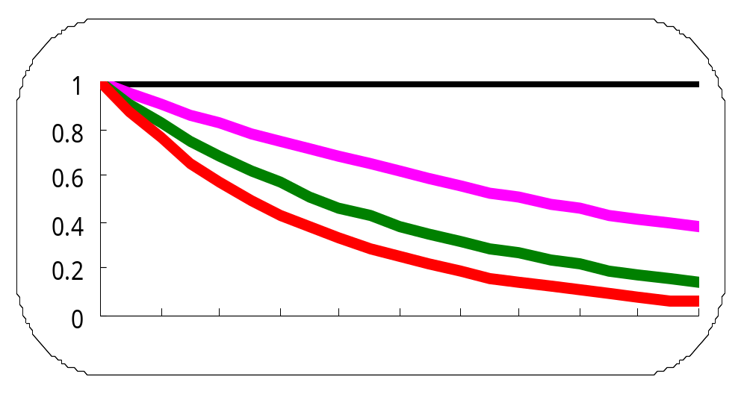
Graphic View of the Discounting Process
Relationship among Present Value, Interest Rates, and Time
Present Value of $1
i= 0%
i= 5%
i= 10%
i= 15%
2
4
6
8
10
12
14
16
18
20
Periods

Slide 18
Annuity
An annuity is a series of payments of an equal amount at fixed intervals for a specified number of periods
Ordinary (deferred) annuity has payments at the end of each period
Annuity due has payments at the beginning of each period
FVA_{n} is the future value of an annuity over n periods

Slide 19
Future Value of an Annuity
The future value of an annuity is the amount received over time plus the interest earned on the payments from the time received until the future date being valued
The future value of each payment can be calculated separately and then the total summed

Slide 20
Future Value of an Annuity
If you deposit $100 at the end of each year for three years in a savings account that pays 5% interest per year, how much will you have at the end of three years?
0
5%
1
2
3
100
100
100.00
= 100 (1.05)⁰
105.00 = 100 (1.05)¹
110.25 = 100 (1.05)²
315.25

Slide 21
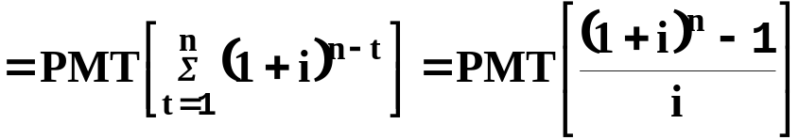
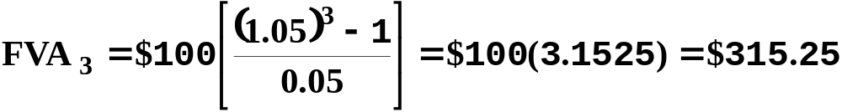
Future Value of an Annuity

Slide 22
Annuities Due
If the three $100 payments had been made at the beginning of each year, the annuity would have been an annuity due.
Each payment would shift to the left one year and each payment would earn interest for an additional year (period).

Slide 23
Future Value of an Annuity Due
$100 at the start of each year
0
5%
1
2
3
100
100
100
105.00 = 100 (1.05)¹
110.25 = 100 (1.05)²
115.7625 = 100 (1.05)³
331.0125

Slide 24
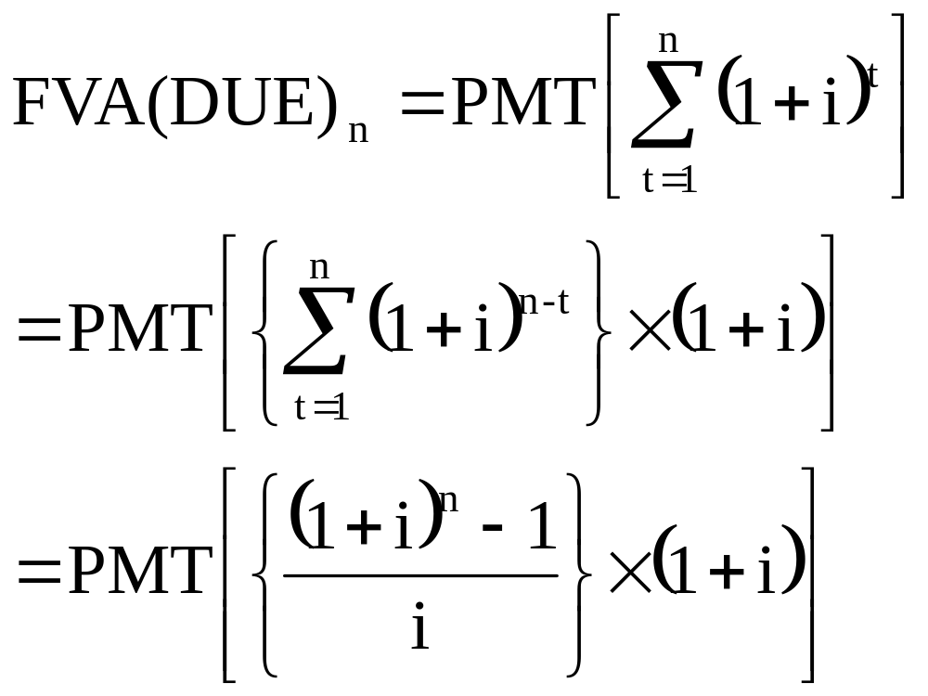
Future Value of an Annuity Due
Numerical solution:

Slide 25
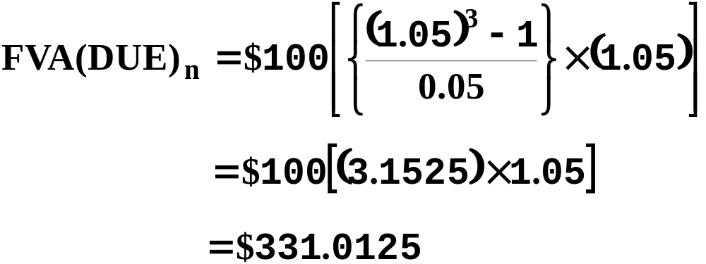
Future Value of an Annuity Due
Numerical solution:

Slide 26
Present Value of an Annuity
If you were offered a three-year annuity with payments of $100 at the end of each year
Or a lump sum payment today that you could put in a savings account paying 5% interest per year
How large must the lump sum payment be to make it equivalent to the annuity?

Slide 27
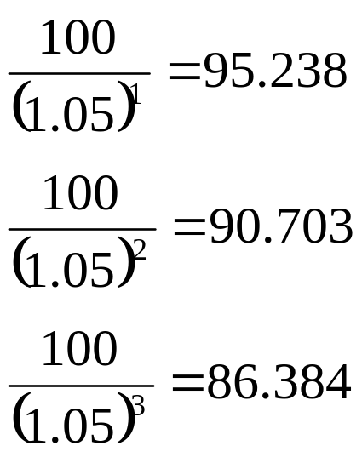
Present Value of an Annuity
0
5%
1
2
3
100
100
100
272.325

Slide 28
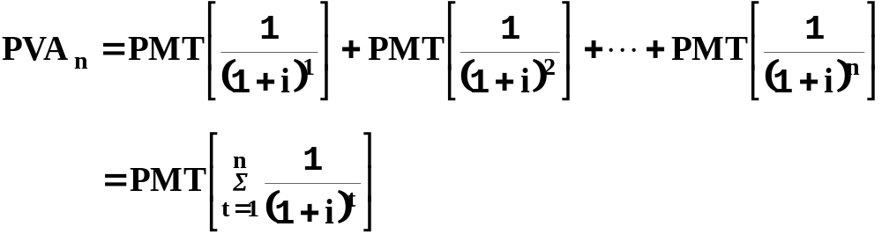
Present Value of an Annuity
Numerical solution:

Slide 29
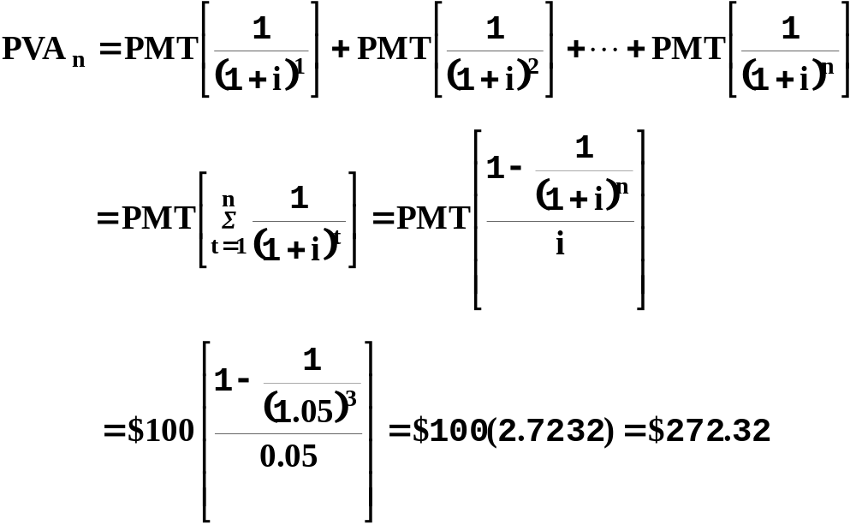
Present Value of an Annuity

Slide 30
Present Value of an Annuity Due
Payments at the beginning of each year
Payments all come one year sooner
Each payment would be discounted for one less year
Present value of annuity due will exceed the value of the ordinary annuity by one year’s interest on the present value of the ordinary annuity

Slide 31
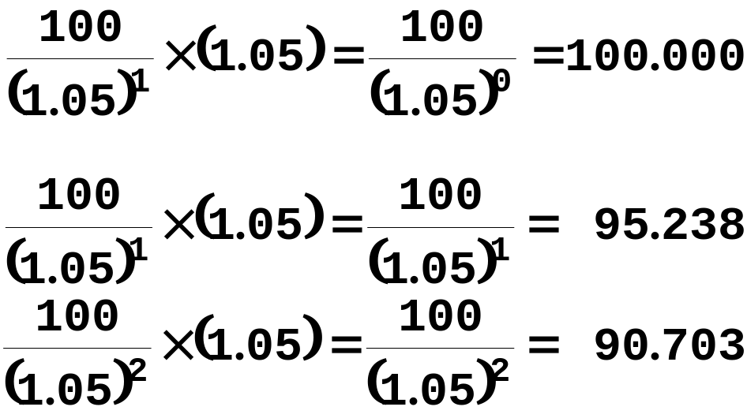
Present Value of an Annuity Due
0
5%
1
2
3
100
100
285.941

Slide 32
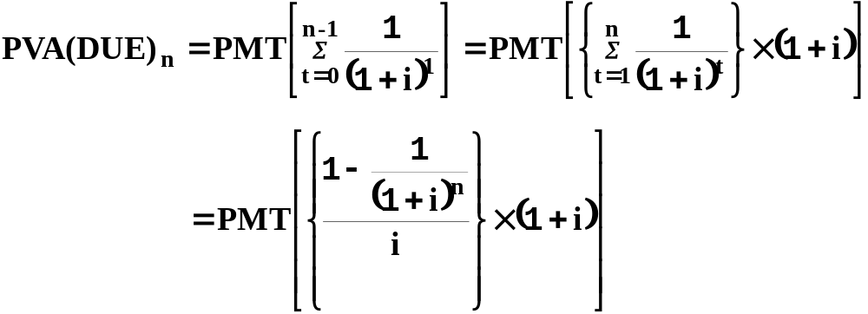
Present Value of an Annuity Due
Numerical solution:

Slide 33
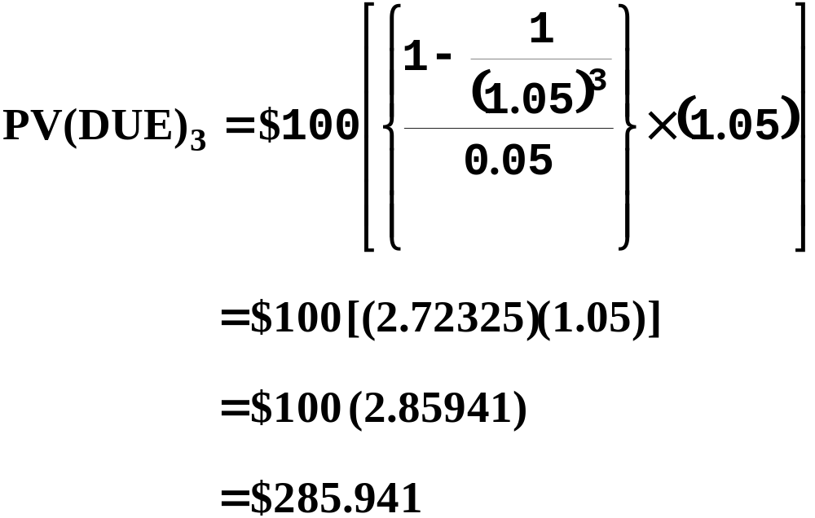
Present Value of an Annuity Due

Slide 34
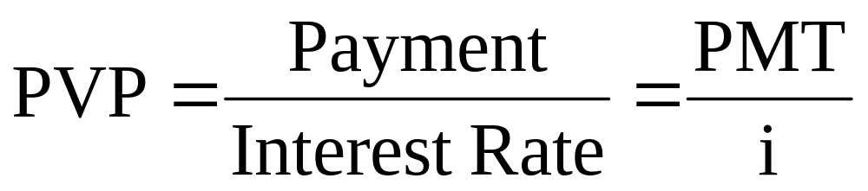
Perpetuities
Perpetuity - a stream of equal payments expected to continue forever
Consol - a perpetual bond issued by the British government to consolidate past debts; in general, and perpetual bond

Slide 35
Uneven Cash Flow Streams
Uneven cash flow stream is a series of cash flows in which the amount varies from one period to the next
Payment (PMT) designates constant cash flows
Cash Flow (CF) designates cash flows in general, including uneven cash flows

Slide 36
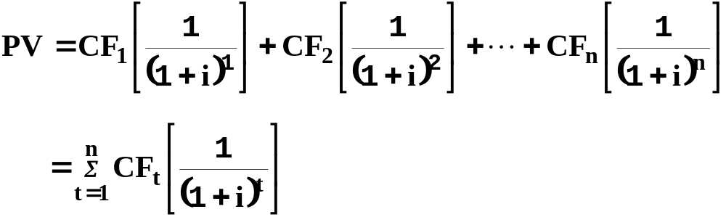
Present Value of
Uneven Cash Flow Streams
PV of uneven cash flow stream is the sum of the PVs of the individual cash flows of the stream

Slide 37
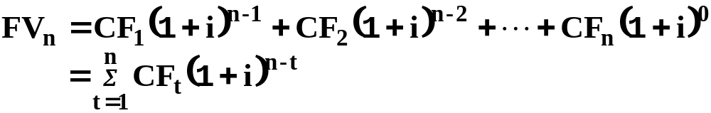
Future Value of
Uneven Cash Flow Streams
Terminal value is the future value of an uneven cash flow stream

Slide 38
Amortized Loans
Loans that are repaid in equal payments over its life
Borrow $15,000 to repay in three equal payments at the end of the next three years, with 8% interest due on the outstanding loan balance at the beginning of each year

Slide 39
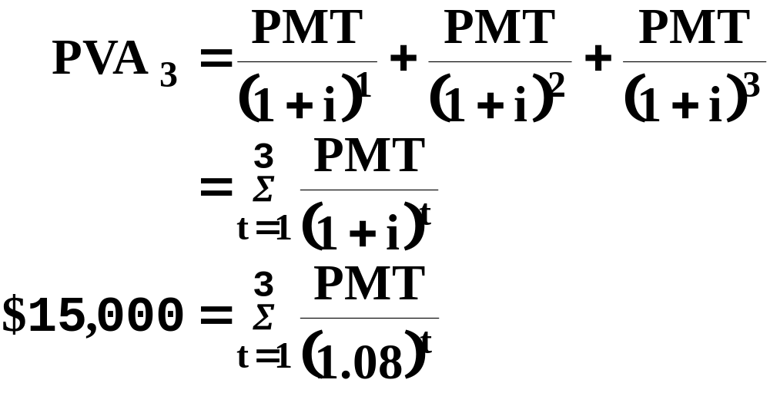
Amortized Loans
0
8%
1
2
3
15,000
PMT
PMT
PMT

Slide 40
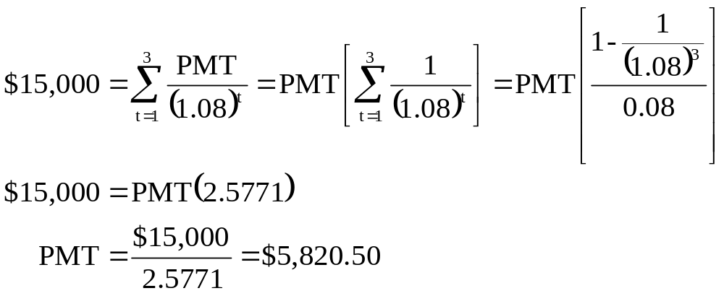
Amortized Loans
Numerical Solution:

Slide 41
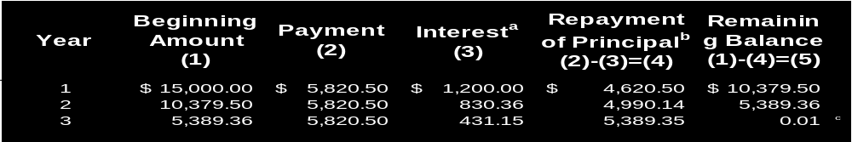
Amortized Loans
Amortization Schedule shows how a loan will be repaid with a breakdown of interest and principle on each payment date
ªInterest is calculated by multiplying the loan balance at the beginning of the year by the interest rate. Therefore, interest in Year 1 is $15,000(0.08) = $1,200; in Year 2, it is $10,379.50(0.08)=$830.36; and in Year 3, it is $5,389.36(0.08) = $431.15 (rounded).
^{b}Repayment of principal is equal to the payment of $5,820.50 minus the interest charge for each year.
^{c}The $0.01 remaining balance at the end of Year 3 results from rounding differences.

